Slide 1

TEALS Minecraft Project
Lecture 1: Intro to Minecraft Forge

Slide 2
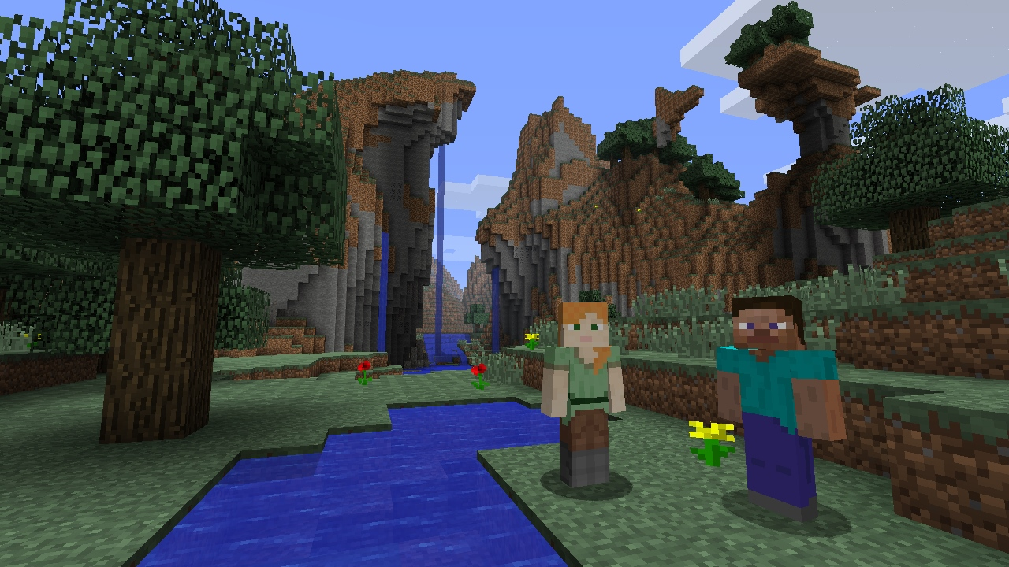
Unit 1 Objectives
Install Minecraft Forge
Create and explore a single-player Minecraft World

Slide 3
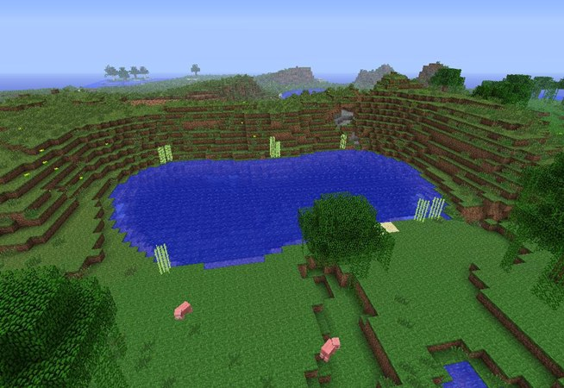
What is Minecraft?
Open world game, never ending generation
Very blocky — “8-bit” styled
Millions of players all around the world
Originally an “indie” (independently developed) game; commercially released in 2011; acquired by Microsoft in 2014
Many types of game play: survival, creative, adventure, single-player, multi-player, etc
Notes:
Wikipedia page has some good info to share: https://en.wikipedia.org/wiki/Minecraft

Slide 4
What is Minecraft?
Minecraft world consists of
Blocks → the landscape and geographic features
Items → plants, tools, and other game objects
Entities → players and other creatures

Slide 5
LAB: Let’s Mod Minecraft!
“Modding” is slang for modifying an existing game.
In this project, we will mod a stand-alone Minecraft client using Forge.
A “client” is one of many programs that talk to a “server”. While you can also mod Minecraft servers (to host custom games, etc), we will only be modifying a client that runs alone.

Slide 6
First Task: Install Minecraft Forge

Slide 7
Second Task: Play Minecraft
Main Menu
Single Player → Create your own world, play alone
Multiplayer → Play with others on a server. Not used in this class
Movement
w → move forward (double-tap to sprint)
a → move left
s → move backwards
d → move right
<space> → jump (if flying, move upwards). You can hold down
<space> while moving to climb up hills.
<left shift> → sneak
<space><space> → fly
<shift> → move downwards when flying

Slide 8
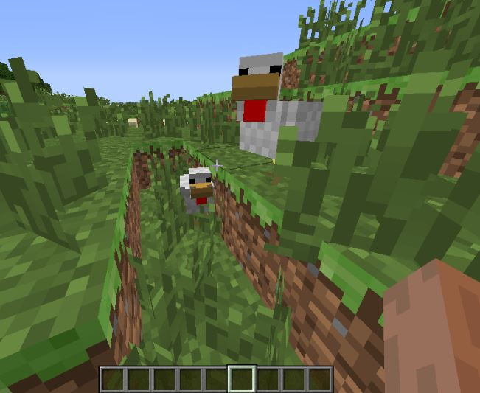
Play Minecraft
Inventory
Composed of all items you are currently carrying
Active items are in your “hotbar” at the bottom
The hotbar has slots numbered 1 to 9. To select an item in your “hotbar”, use the mouse wheel to scroll and select which slot (or use the numbers 1 through 9).
e → Open your inventory. You’ll see creative inventory categories above and below the inventory popup. Move items/blocks to your slots.
<esc> → close inventory
Wielding Items
Choose slot ‘1’ to ‘9’
q → throw item
<right click> → apply item
Wielding Blocks
Choose slot ‘1’ to ‘9’
<left click> → break block / attack
<right click> → place block

Slide 9
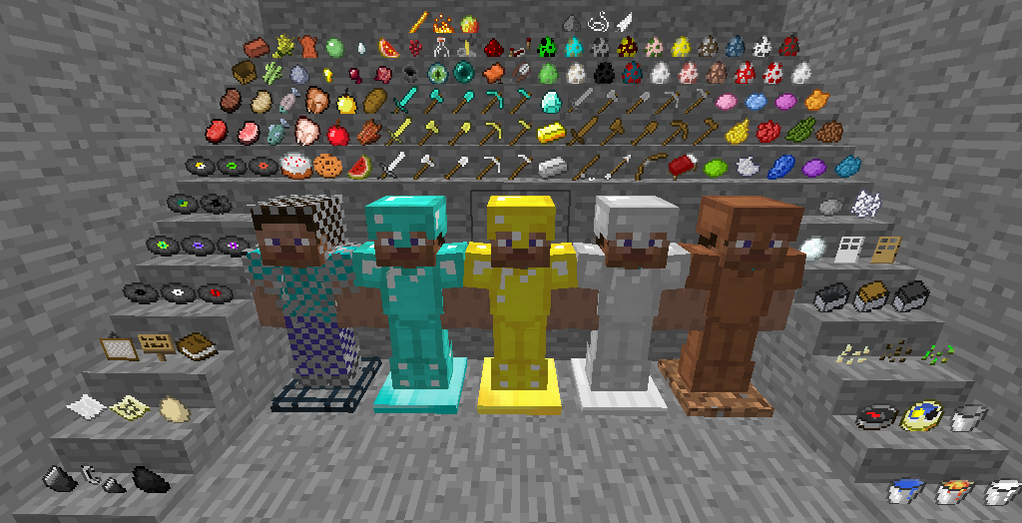
What is computer science all about?
Go to School
Play Minecraft

